Slide 1

Bikeshare Optimization Problems (Review)
Hannah DeBruin
Weekly Meeting: Transit Data Subgroup
03/20/23

Slide 2
Western Minnesota Update
Donna Anderson (new project contact for CCT) only started deploying paper surveys ~March 13th, will collect and send all responses March 24th
Transit Agency: | NTD Monthly Avg Ridership | Q Mn Zip Codes Only | Q Service Area Zip Codes Only | Paper
Central Community Transit (CCT) | 17797, 99 | 143 | 39
City of Morris Transit | 4278, 76 | 131 | 38 | 1
None of the above |  | 1 | 1 | 1
Prairie Five Rides | 11242, 76 | 10 | 9 | 29
Transit Alternatives (Productive Alternatives, The Otter Express) | 7626, 79 | 121 | 23 | 11
Tri-Cap Transit Connection | 10460, 109 | 120 | 39 | 10
United Community Transit | 14384, 81 | 16 | 14 | 1
Sum | , 520 | 542 | 163 | 53
Weekly Meeting (03/21/2023)
Hannah DeBruin

Slide 3
Lit Review – Existing Optimization Methods
Rank candidate locations
Usually involved an AHP survey about proximity to demand indicators
TOPSIS ranking (2), VIKOR method, MOORA ranking
Predefined candidate location points
Maximizing demand coverage with known O/D trip demand
Taken from multimodal transportation demand model or travel survey
Typically took candidate station locations as centroids of zones
Some modeled demand both spatially and temporally, considered rebalancing
One model minimized inequalities in demand coverage between population groups
Maximizing demand coverage with O/D trip demand modeled/approximated from demand indicators
Some used existing urban systems’ activity and proximity to demand indicators to model influence of demand indicators (using neural network, regression methods)
Other studies have studied relationship between existing system activity and demand indicators, but none in a small urban area context
Re-located stations onto candidate locations using predicted O/D
OR maximized accessibility to demand points (such as jobs)
Two models minimized costs, non-variable station and bicycle cost
bi-level model between system planner and users minimizing travel time (lots of modeling)
combinative model for maximizing utility and minimizing cost
Weekly Meeting (03/21/2023)
Hannah DeBruin

Slide 4
Lit Review – Existing Optimization Methods
Most models using AHP provided a ranking of valuable candidate locations, not a subset of selected optimal locations
Almost all approaches required pre-defined candidate locations/zones (one used continuous bike network)
Raster hotspot/propensity analysis in my method removes this step
Demand coverage models require known trip demand, or some specification of how to treat demand indicators which may be difficult to determine in small urban area agencies
My approach will use AHP-generated criteria weights
Weekly Meeting (03/21/2023)
Hannah DeBruin

Slide 5
Lit Review – Existing Optimization Methods
Many studies come from large urban areas with existing systems, focus on demand coverage for regular use (ie commuting, etc)
In small urban areas, other objectives might be important:
Regular use might aim to cover jobs/commercial areas
Recreational use would cover parks/trails, tourist sites
First/last mile connection to limited transit network would cover transit stops
Prioritizing public/private partnerships would cover major employment campuses
Prioritizing transportation equity would cover disadvantaged neighborhoods
The DC Capital Bikeshare and Twin Cities Mobility Hubs propensity analysis both divided up candidate station hot spots to meet different goals:
DC Capital Bikeshare had “Ridership” for regular use/commuting, “Revenue” for casual use/tourism, “Public Welfare” for servicing disadvantaged communities
Twin Cities had “Connect the Region” for regular use/commuting, “Expand and Integrate Multimodal Travel Options” for connecting to transit, and “Advance Equity” for servicing disadvantaged communities
Both included distribution policy of different goals (in DC twice as many “Public Welfare” than “Revenue”, a third each type for Twin Cities)
Weekly Meeting (03/21/2023)
Hannah DeBruin

Slide 6
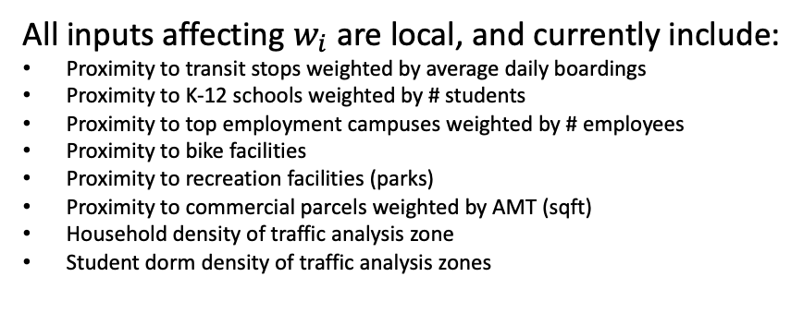
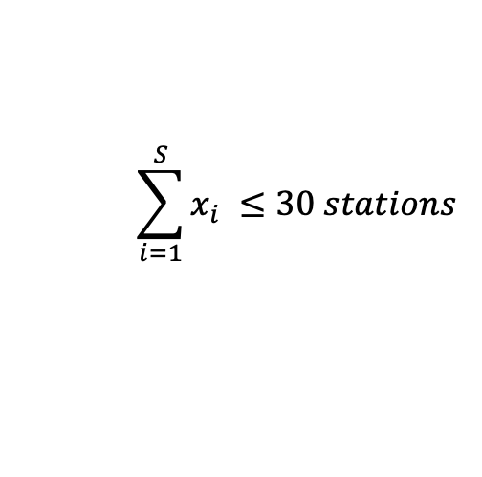
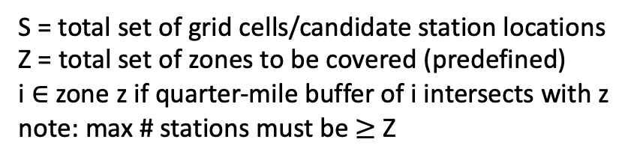



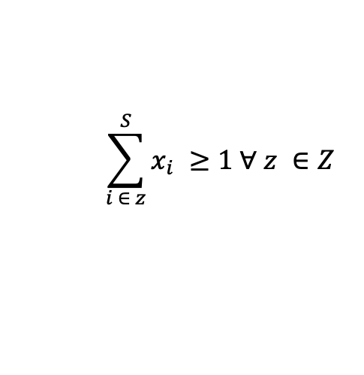
Current Optimization Approach
All inputs affecting $w_{i}$ are local, and currently include:
Proximity to transit stops weighted by average daily boardings
Proximity to K-12 schools weighted by # students
Proximity to top employment campuses weighted by # employees
Proximity to bike facilities
Proximity to recreation facilities (parks)
Proximity to commercial parcels weighted by AMT (sqft)
Household density of traffic analysis zone
Student dorm density of traffic analysis zones
max f(x) = $\sum_{i=1}^{S}{w_{i}x_{i}}$
s.t.
$x_{i}=[0,1]$ $∀ i ∈ S$
$x_{i}+x_{j}≤1 ∀$ dist($x_{i},x_{j})≤1320 ft ∀ i,j ∈S$
$$\sum_{i=1}^{S}{x_{i} ≤30 stations}$$
Revised inputs considering literature review:
Proximity to transit stops weighted by average daily boardings
Proximity to K-12 schools weighted by # students
Proximity to top employment campuses weighted by # employees
Proximity to bike facilities (potential to weight by facility type? ie bike lane, sharrow)
Proximity to recreation facilities (parks)
Proximity to commercial parcels weighted by AMT (sqft)
not commonly available data, switch to LEHD data about job points
potential to divide out by total # jobs, low-income jobs, retail, food services, arts/entertainment jobs
Household density of traffic analysis zone
Student dorm density of traffic analysis zones
ACS census block group data weighted by median income, # vehicles available
$$\sum_{i ∈ z}^{S}{x_{i} ≥1 ∀ z ∈Z }$$
$$x_{i}$$
=1 if station location selected, 0 if station location not selected
S = total set of grid cells/candidate station locations
Z = total set of zones to be covered (predefined)
i $∈$ zone z if quarter-mile buffer of i intersects with z
note: max # stations must be $≥$ Z
Weekly Meeting (03/21/2023)
Hannah DeBruin

Slide 7

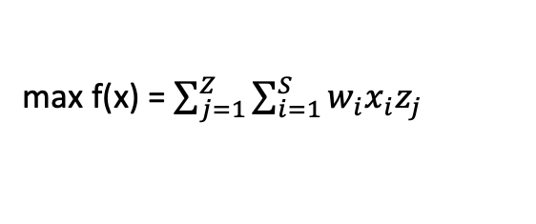
Current Optimization Approach
Spatial value index only considers candidate station location value, not utility as a network
Maximal demand coverage models in literature often looked at interzonal/interstation demand and maximize either # demanded trips covered or improvements in accessibility between demand points with a selected subset of stations
Could reformulate to consider demand indicators as demand points instead of proximity values, and maximize improvements to accessibility, comparing a no bikeshare (walking and transit modes only) accessibility between all relevant demand points, with quantity weights (ie # employees, # average daily boardings, # students) and AHP weights for specific demand indicators’ relative importance
But this would not reflect actual trip quantity demanded between points (example, there might not be lots of actual demand between campus and an industrial district with a lot of employees and this method would likely treat that as an important link)
Spatial distribution is ensured by minimum distance constraint and zone coverage constraint
Zones are currently predefined, but could be subbed for zones clustered by spatial index value or traffic analysis zones
Maybe in a real world setting it simply doesn’t make sense to have any stations in less dense areas/on edges of town
Could reformulate to include set coverage as part of the objective instead of as a constraint, ie
max f(x) = $\sum_{i=1}^{S}{w_{i}x_{i}}$
s.t.
$x_{i}=[0,1]$ $∀ i ∈ S$
$x_{i}+x_{j}≤1 ∀$ dist($x_{i},x_{j})≤1320 ft ∀ i,j ∈S$
$$\sum_{i=1}^{S}{x_{i} ≤30 stations}$$
$$\sum_{i ∈ z}^{S}{x_{i} ≥1 ∀ z ∈Z }$$
$$x_{i}$$
=1 if station location selected, 0 if station location not selected
S = total set of grid cells/candidate station locations
Z = total set of zones to be covered (predefined)
i $∈$ zone z if quarter-mile buffer of i intersects with z
note: max # stations must be $≥$ Z
max f(x) = $\sum_{j=1}^{Z}{\sum_{i=1}^{S}{w_{i}x_{i}z_{j}}}$
where $z_{j}$ is 1 if the zone is covered by i, 0 if not
Weekly Meeting (03/21/2023)
Hannah DeBruin

Slide 8
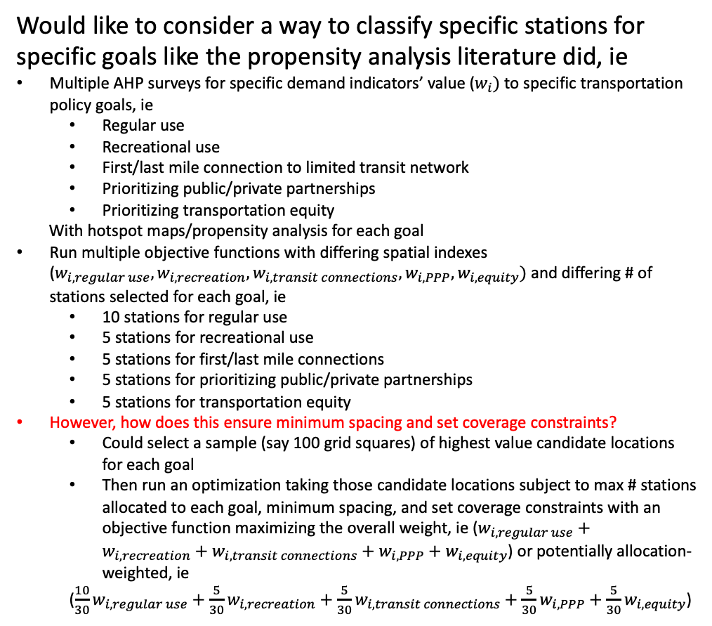
Current Optimization Approach
Would like to consider a way to classify specific stations for specific goals like the propensity analysis literature did, ie
Multiple AHP surveys for specific demand indicators’ value ($w_{i})$to specific transportation policy goals, ie
Regular use
Recreational use
First/last mile connection to limited transit network
Prioritizing public/private partnerships
Prioritizing transportation equity
With hotspot maps/propensity analysis for each goal
Run multiple objective functions with differing spatial indexes ($w_{i, regular use},w_{i, recreation},w_{i, transit connections},w_{i, PPP},w_{i, equity})$and differing # of stations selected for each goal, ie
10 stations for regular use
5 stations for recreational use
5 stations for first/last mile connections
5 stations for prioritizing public/private partnerships
5 stations for transportation equity
However, how does this ensure minimum spacing and set coverage constraints?
Could select a sample (say 100 grid squares) of highest value candidate locations for each goal
Then run an optimization taking those candidate locations subject to max # stations allocated to each goal, minimum spacing, and set coverage constraints with an objective function maximizing the overall weight, ie ($w_{i, regular use}+w_{i, recreation}+w_{i, transit connections}+w_{i, PPP}+w_{i, equity}$) or potentially allocation-weighted, ie
(${\frac{10}{30}w}_{i, regular use}+{\frac{5}{30}w}_{i, recreation}+{\frac{5}{30}w}_{i, transit connections}+{\frac{5}{30}w}_{i, PPP}+{\frac{5}{30}w}_{i, equity}$)
max f(x) = $\sum_{i=1}^{S}{w_{i}x_{i}}$
s.t.
$x_{i}=[0,1]$ $∀ i ∈ S$
$x_{i}+x_{j}≤1 ∀$ dist($x_{i},x_{j})≤1320 ft ∀ i,j ∈S$
$$\sum_{i=1}^{S}{x_{i} ≤30 stations}$$
$$\sum_{i ∈ z}^{S}{x_{i} ≥1 ∀ z ∈Z }$$
$$x_{i}$$
=1 if station location selected, 0 if station location not selected
S = total set of grid cells/candidate station locations
Z = total set of zones to be covered (predefined)
i $∈$ zone z if quarter-mile buffer of i intersects with z
note: max # stations must be $≥$ Z
Weekly Meeting (03/21/2023)
Hannah DeBruin

